Slide 1

TYRE DYNAMICS
​
​
​
​
Faculty,
​
Dr. Hariharan Sankara Subramanian
SOME, Associate Professor ​
Mathanesh A B 126009058​
Sankara Hari Sudan 126009105​
Nitheeshkumar S 126009068​
​
nkadra Subramanian​

Slide 2
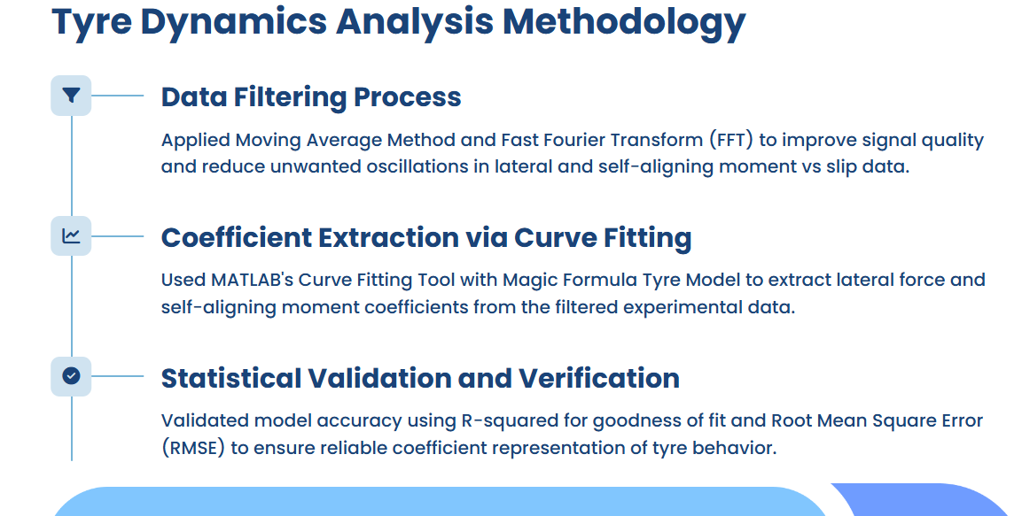

Slide 3
Filtering(For both lateral and self-aligning moment vs slip):
To improve signal quality in lateral and self-aligning moment vs slip data, two filtering methods were applied:
Moving Average Method:
  Smooths data by averaging sample points
  Removes large variations and oscillations
  Widely used in data analytics for noise reduction
Fast Fourier Transform (FFT):
  Converts slip-series slip data to frequency domain
  Identifies and isolates high-frequency noise components
  After suppressing noise, inverse FFT reconstructs smoother signals
  These methods significantly reduce unwanted oscillations, enhancing data fidelity for accurate modeling.

Slide 4
Extracting Tyre Model Coefficients Using Curve Fitting:
Coefficients for lateral force and self-aligning moment were derived from established models:
  The Magic Formula Tyre Model
  Tyre and Vehicle Dynamics by Hans B. Pacejka
MATLAB’s Curve Fitting Tool was used to fit custom equations to filtered data.
Statistical validation metrics ensured model accuracy:
  R-squared: Measures goodness of fit
  Root Mean Square Error (RMSE): Quantifies prediction errors
  These checks confirm the extracted coefficients reliably represent the tyre behavior.

Slide 5
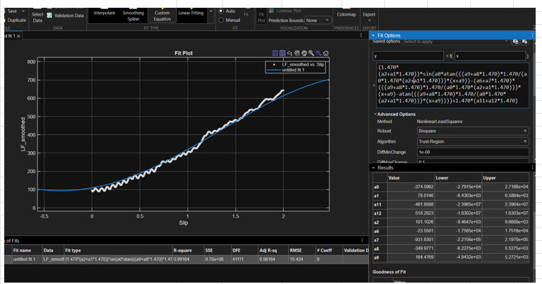
Lateral force vs Slip:

Slide 6
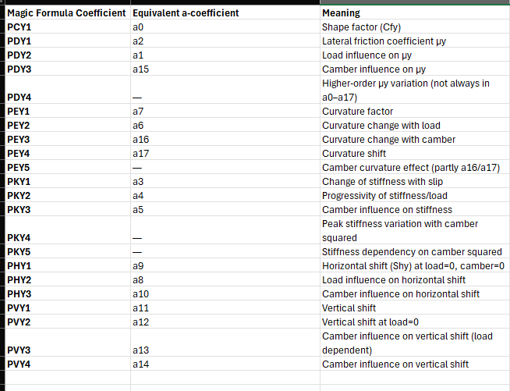
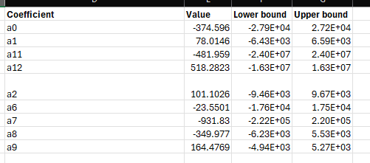
Lateral coefficients:
The extracted Lateral Coefficients is listed out.

Slide 7
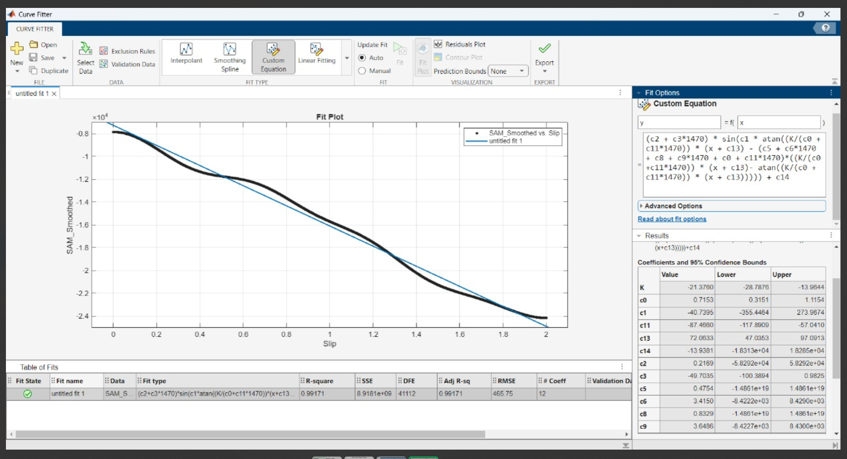
Self-Aligning vs slip

Slide 8
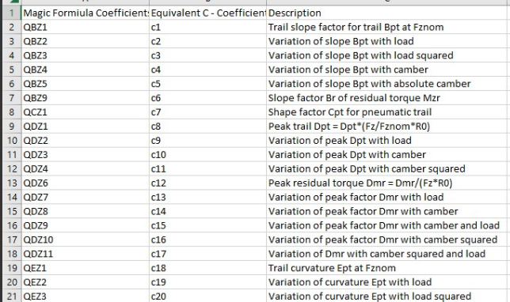
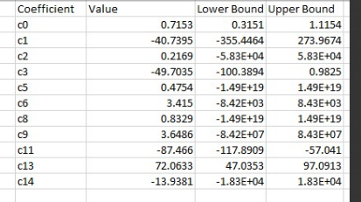
Self-Aligning Moment coefficients:

Slide 9
Validation Metrics for Curve Fitting Accuracy
Accuracy of coefficient extraction was validated using:
  R-squared (R²): Indicates how well the model fits the data (values close to 1 signify excellent fit)
  Root Mean Square Error (RMSE): Measures average deviation between observed and predicted values (value close to 0)
High R² and low RMSE values confirm that the filtering and curve fitting methods yield reliable coefficients.
This ensures confidence in using these coefficients for predictive Tyre models.

Slide 10
Summary
 | Coefficients listed out by TVS | Coefficients Obtained
Lateral force vs Slip | 42 | 9
Self-Aligning Moment | 34 | 11

Slide 11
Key Takeaways and Next Steps
Data filtering via moving average and FFT effectively reduces noise and oscillations in Tyre slip data.
Accurate lateral and self-aligning moment coefficients were extracted and validated statistically.
Improved data quality enhances confidence in Tyre model predictions for engineering applications.

Slide 12
References:
H. B. Pacejka and E. Bakker, “The magic formula tyre model,” Vehicle System Dynamics: International Journal of Vehicle Mechanics and Mobility, vol. 21, no. S1, pp. 1–18, 1992
H. B. Pacejka, Tyre and Vehicle Dynamics, 2nd ed. Oxford, U.K.: Butterworth-Heinemann, 2006.
https://www.edy.es/dev/docs/pacejka-94-parameters-explained-a-comprehensive-guide/

